Slide 1

Vision Guided AI System
Presenter : Amit Sharma
Program: Executive M.Tech AI & ML
Guide: Dr. Harkeerat

Slide 2
Objective/Vision
AI and Computer Vision enable perception-driven automation.
Need for adaptive visual systems that can perceive, understand, and act in complex industrial settings.
Ambition: Build a general-purpose visual AI system applicable to forklifts, robotic arms, and AGVs.
Long-Term Vision: General-purpose perception-to-action framework adaptable to any robotic or industrial automation platform.
Vision Guided in Robotics
Content generation - Open Areas.

Slide 3
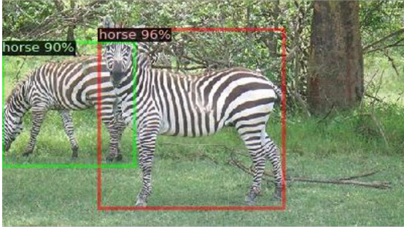
Base Paper - Sarkar et al. (2024) — Open-Set Object Detection
Project Goal
Deliver a faithful, paper‑accurate implementation of “Open‑Set Object Detection by Aligning Known Class Representations” (WACV 2024)
Systematically identify gaps between the current implementation and the paper’s methodology
Define a clear roadmap to reach paper‑level performance, evaluation rigor, and architectural completeness
Problem & Motivation
Conventional closed‑set detectors fail on unseen objects, often producing high‑confidence misclassifications
e.g., zebra predicted as horse due to semantic similarity

Slide 4
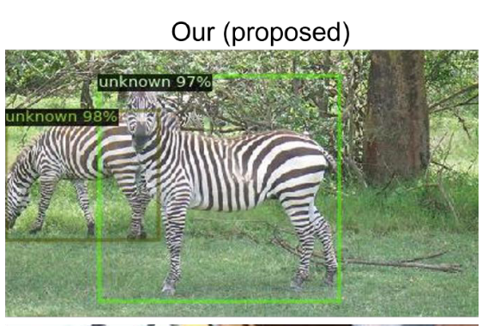
Base Paper - Sarkar et al. (2024) — Open-Set Object Detection
RPN objectness overfits to known training categories
Limited generalization
Leads to poor proposal quality for unknown objects
Such failures pose risks in real‑world systems (autonomous platforms, robotics, retail analytics), where incorrect decisions can be unsafe
A robust OSOD system must:
Accurately recognize known classes, and
Flag unfamiliar objects as “unknown” with minimal false confidence to ensure safety and reliability

Slide 5
Paper Contributions
Semantic Clustering (SC)
Aligns ROI image features with CLIP text embeddings to create clear semantic decision boundaries, reducing confusion among semantically similar classes.
Class Decorrelation (CD)
Applies orthogonality constraints on sampled class‑specific features
Enforces low inter‑class correlation, enlarging separation between known class clusters
Object Focus (OF) Loss
Combines centerness and classification‑based objectness into a unified loss
Uses a geometric mean formulation to strengthen objectness learning
Produces more robust proposals, especially for unknown objects

Slide 6
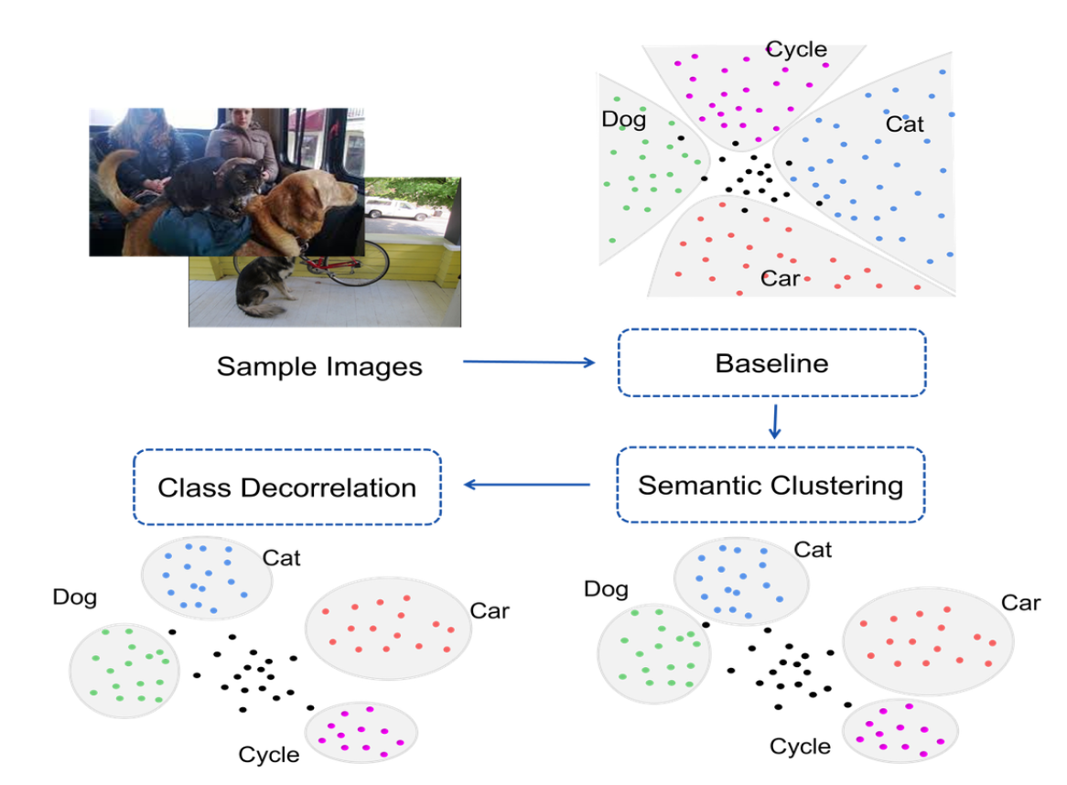
Paper Contributions

Slide 7
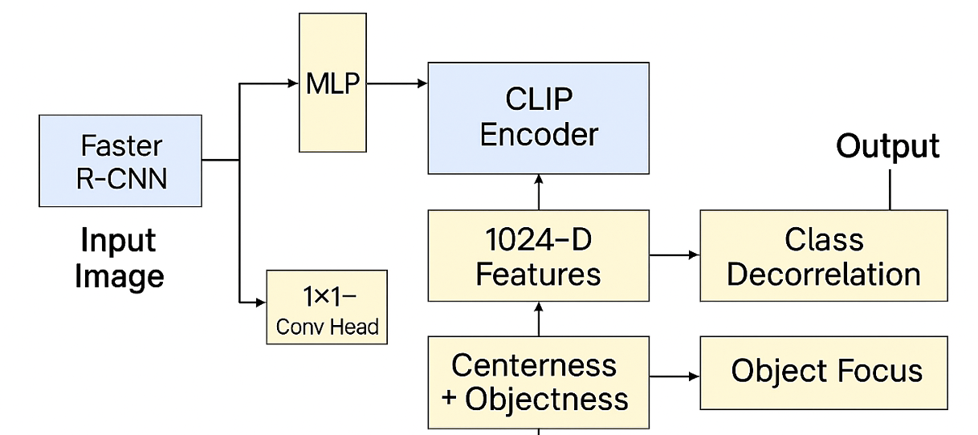
Architecture Overview
Base detector: Faster R–CNN
Added components:
1×1 conv head for centerness + objectness
ROI → MLP → 1024‑D features
CLIP encoder → 1024‑D text embeddings (class names as prompts)
Alignment: ROI feature vectors ↔ CLIP text vectors

Slide 8
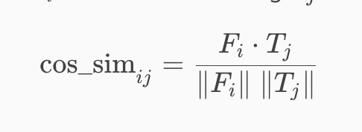
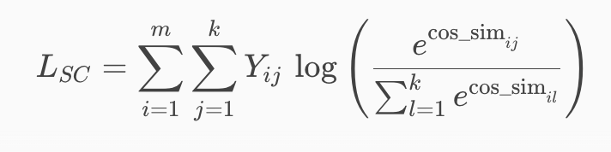
Key Equations
Semantic Clustering (SC)
Align ROI features with CLIP text embeddings to form semantic decision boundaries.
Cosine Similarity between ROI and feature Fi and class embedding Tj.
Semantic clustering loss
Effect: Pulls features toward the correct class cluster → reduces confusion between semantically close classes.

Slide 9
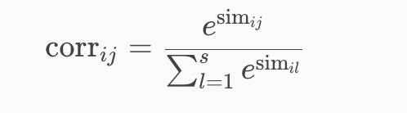
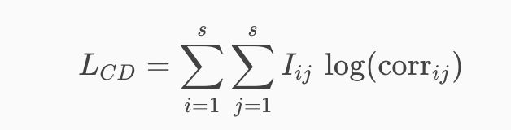
Key Equations
Class Decorrelation (CD)
Enforces orthogonality among class‑specific proposal features to enlarge separation.
Softmax correlation matrix
Class decorrelation loss
Effect: Pushes clusters apart → improved known‑class separation → easier unknown rejection.

Slide 10
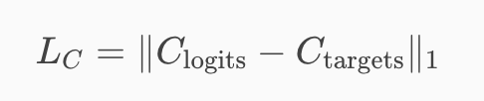

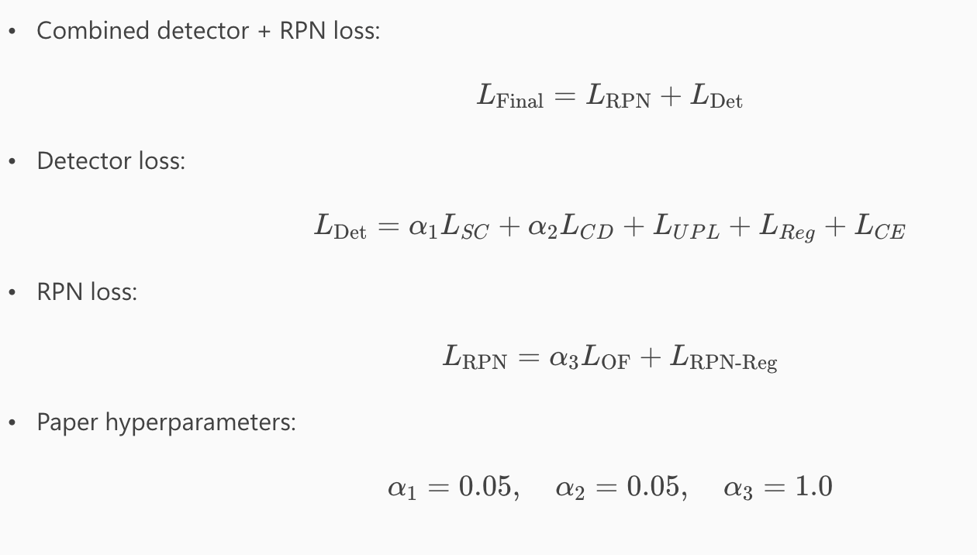
Key Equations
Object Focus (OF) Loss
Enhances unknown proposal quality by combining geometric centerness and RPN objectness.
Centerness Loss & Final Loss:
Paper ablation: geometric mean > addition > multiplication.
Total Training Loss

Slide 11
Evaluation Protocol & Metrics
Datasets:
VOC–COCO T1/T2
T1 → increase #unknown classes
T2 → increase wilderness ratio
Entropy threshold = 0.85 for unknown prediction
Metrics:
mAPₖ (known)
APᵤ (unknown)
WI (Wilderness Impact)
AOSE (Absolute Open‑Set Error)
HMP (Eq. 10) — harmonic mean of known + unknown performance

Slide 12
Current Status
Code: Faster R-CNN + Object Focus RPN;
semantic alignment and decorrelation losses wired;
CLIP prompts (VOC+COCO).
Data: VOC/COCO in place;
placeholder T1/T2 splits
Checkpoint:
Stub run checkpoints/latest.pth (PK ~1.0 on stub; PU/HMP placeholder until unknown GT).
Eval:
PK uses GT;
PU/HMP will be accurate once unknown annotations are available.
Next: add official splits, unknown GT for PU/HMP, set paper hyperparams in config.py, then full GPU training.

Slide 13
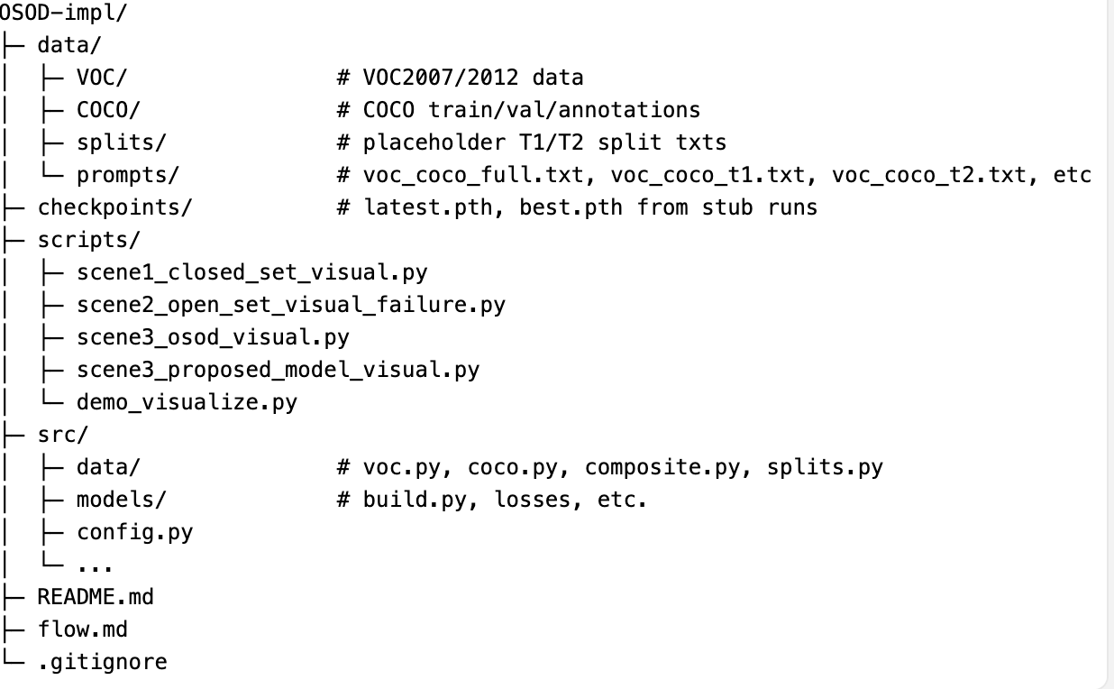
Project Structure – Git Link

Slide 14
Current issues and blockers
Official T1/T2 splits not available: using placeholder split files; need the paper’s VOC–COCO train/val lists to match reported results.
Unknown GT missing: PU/HMP remain placeholder
To compute open-set metrics correctly.
Hyperparameters not paper-aligned: loss weights/temperature and optimizer schedule in config.py need to be set to the paper’s values before full training.
Compute for full training: full paper-scale runs require GPU; current runs are stub/CPU-light only.

Slide 15
Next Steps and Future Scope
Next Steps
Replace placeholder T1/T2 split txts with the official VOC–COCO splits.
Add unknown annotations (e.g., unknown_boxes) so PU/HMP are computed correctly.
Set paper hyperparameters (loss weights, temperature, optimizer/schedule) in src/config.py.
Run full training/eval on GPU; save best checkpoints.
Future Scope
Expand to other backbones or newer detectors for OSOD.
Improve unknown scoring (beyond entropy) and calibration.
Automate reporting/visualization (metrics dashboards, batch demo generation).
Explore additional open-set tasks (incremental detection, domain shifts) using the same framework.

Slide 16
Thank You

